Slide 1


AI Academy computer vision Samsung Electronics. (Classification)
유기윤 (961230@snu.ac.kr)
송주경 (chsjk9005@snu.ac.kr)
자료:
Hyojin Park (wolfrun@snu.ac.kr)
Jisoo Jeong (soo3553@snu.ac.kr)
https://pytorch.org/tutorials/

Slide 2
Table of Contents
Setting Google Colab.
What is PyTorch
Training a classifier (Two Moon, MNIST, CIFAR-10)
Exploring CNN Architectures
Using Torchvision

Slide 3
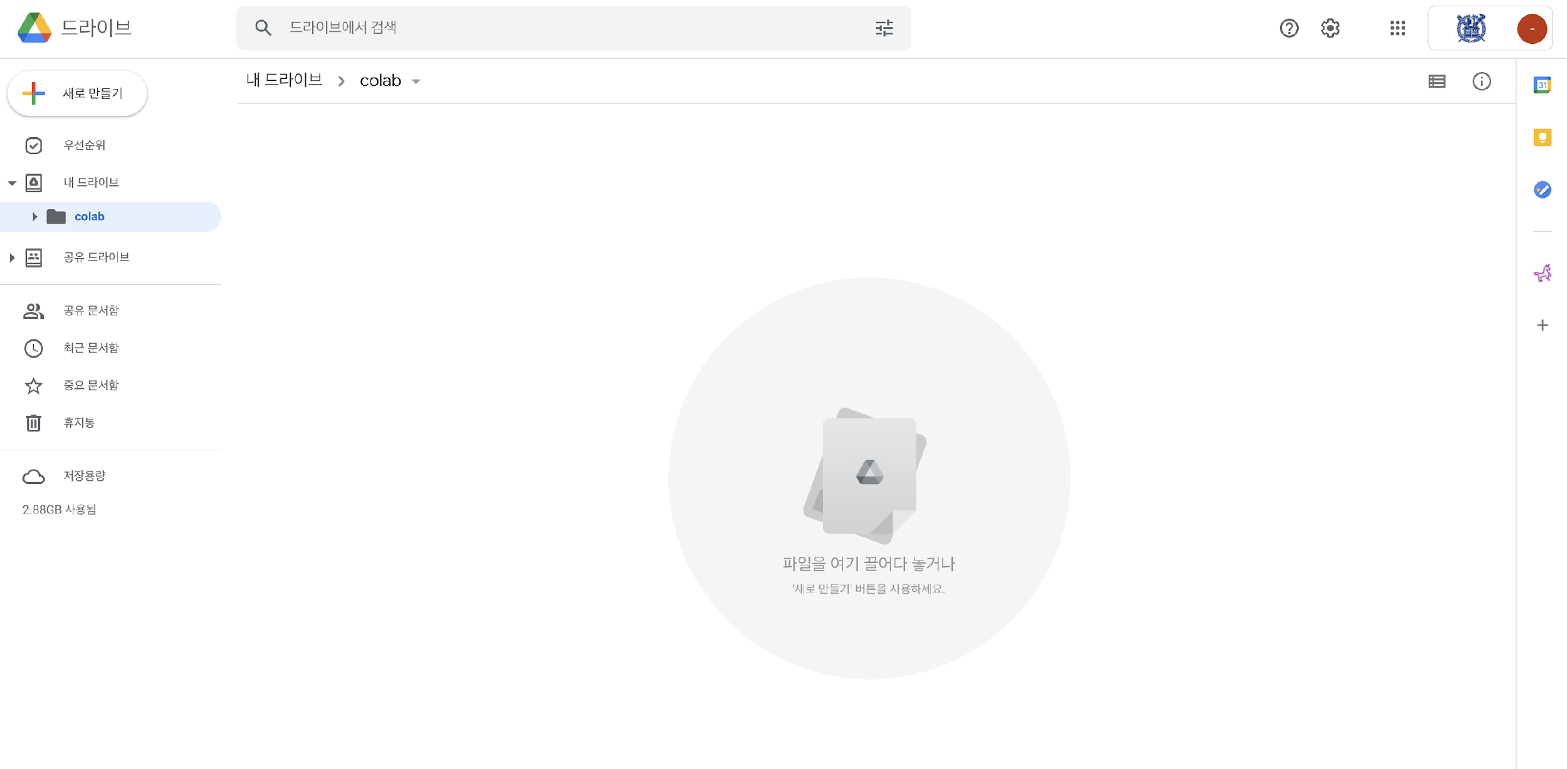
Colab 환경설정
(구글 드라이브에서) 우클릭 후 폴더 생성
https://theorydb.github.io/dev/2019/08/23/dev-ml-colab/

Slide 4
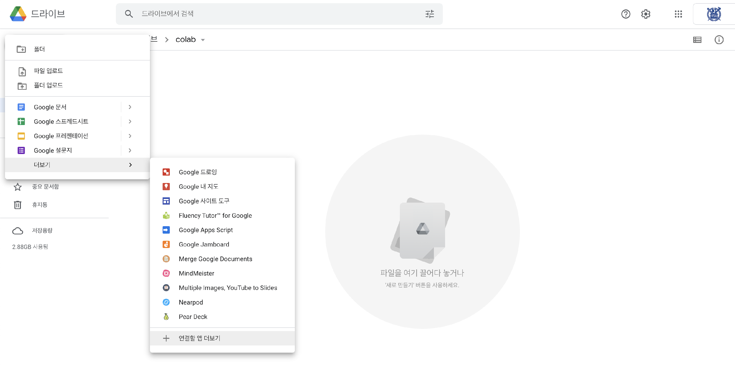
Colab 환경설정
좌상단 (새로 만들기 -> 더보기 -> 연결할 앱 더보기)

Slide 5


Colab 환경설정
Colab 검색후 설치

Slide 6
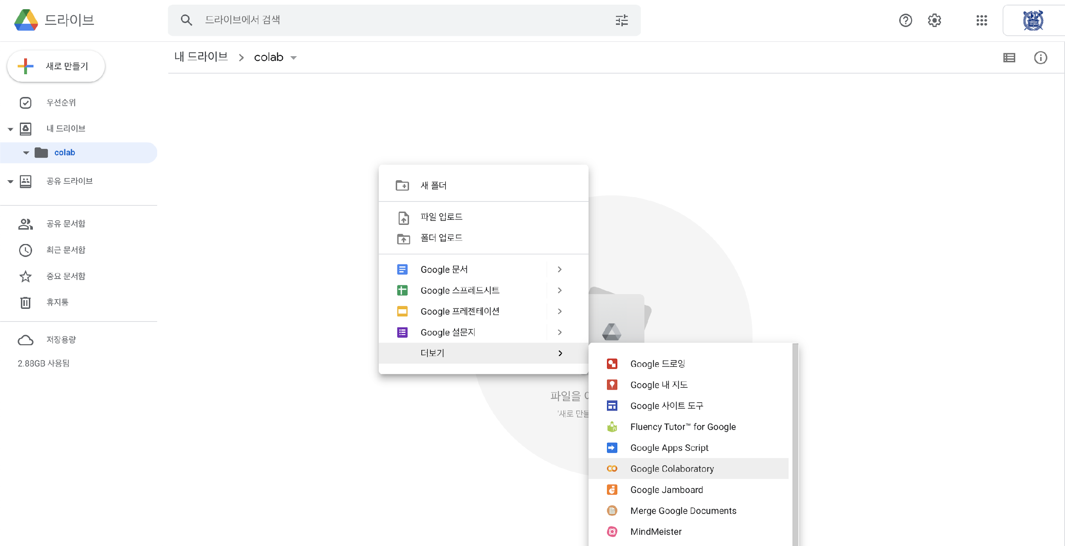
Colab 환경설정
폴더내에서 우클릭 후 더보기 -> google colaboratory 시작

Slide 7
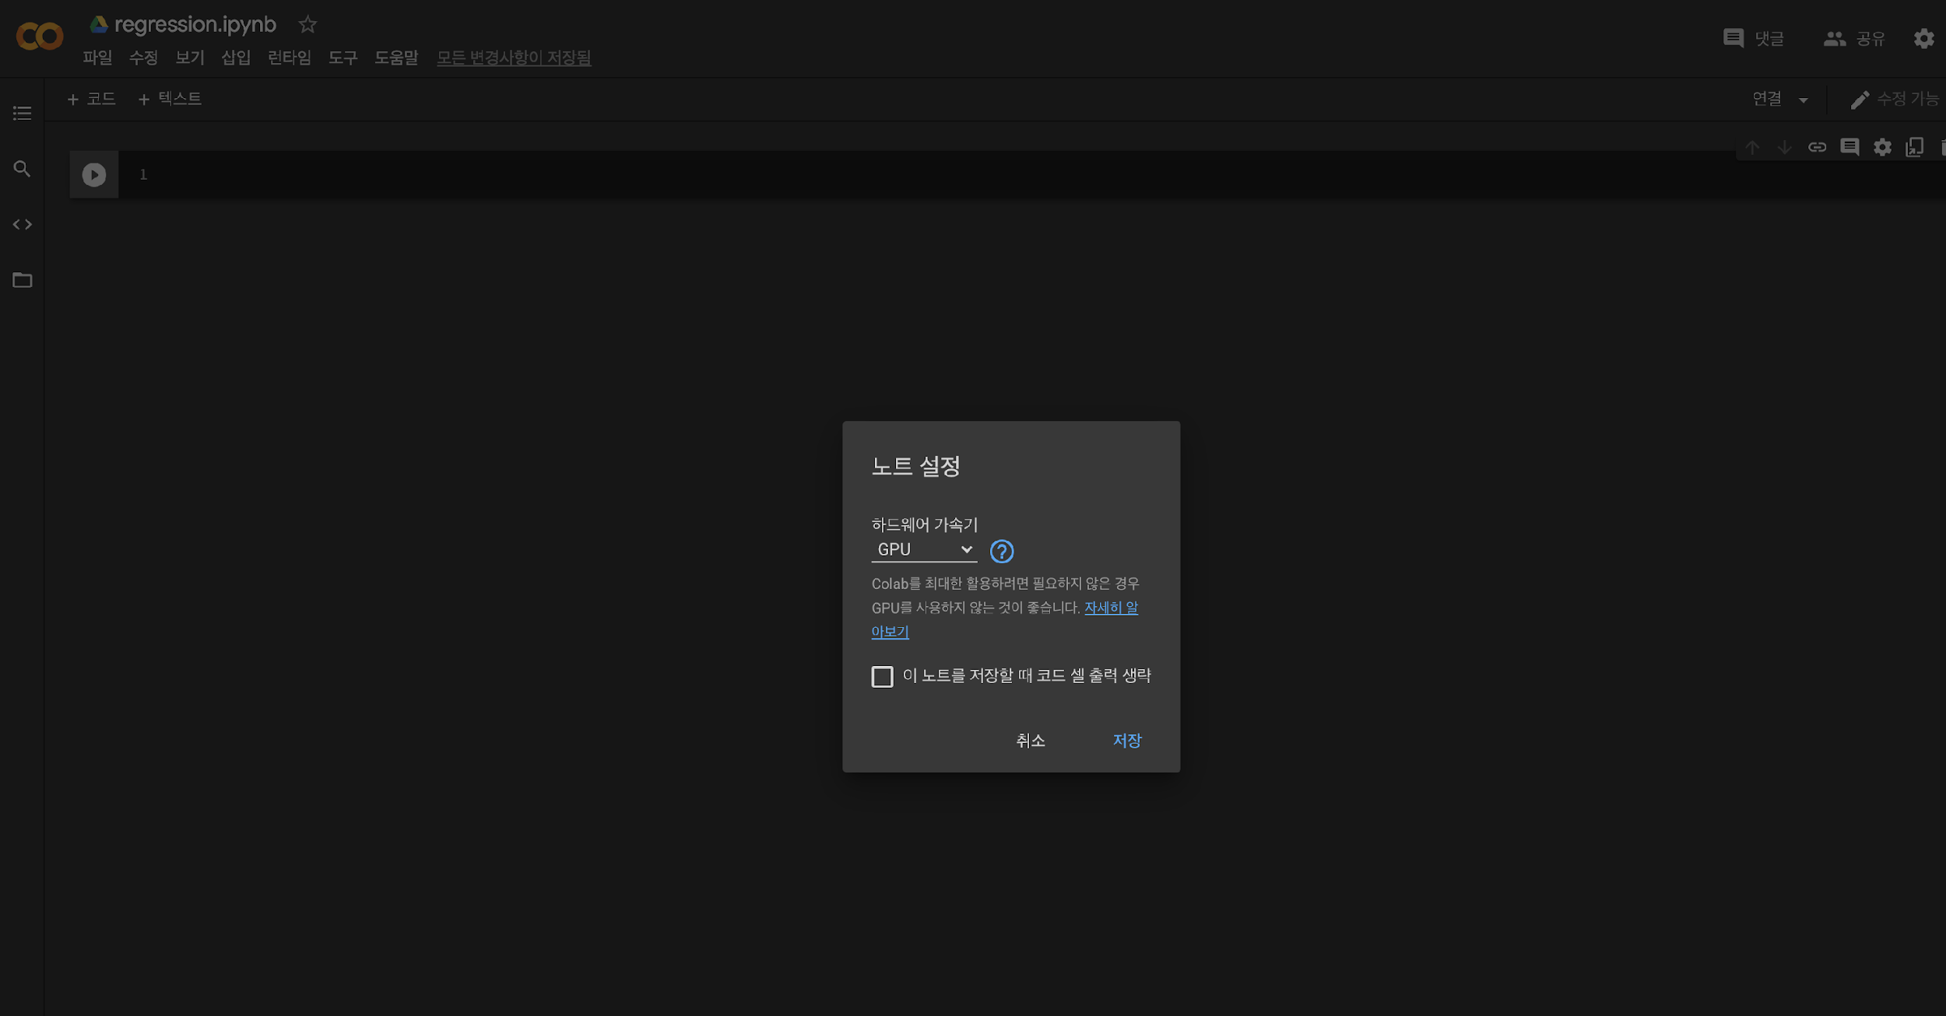
Colab 환경설정
도구 -> 환경설정
런타임 -> 런타임 유형 변경 (가속기 -> GPU)
우상단 -> 연결

Slide 8
1. What is Pytorch?

Slide 9
# see the figure directly
%matplotlib inline
# Python 2/3 compatibility
from __future__ import print_function, division
import itertools
import time
import numpy as np
import matplotlib.pyplot as plt
# Colors from Colorbrewer Paired_12
colors = [[31, 120, 180], [51, 160, 44]]
colors = [(r / 255, g / 255, b / 255) for (r, g, b) in colors]
def plot_confusion_matrix(cm, classes,
normalize=False,
title='Confusion matrix',
cmap=plt.cm.Blues):
"""
This function prints and plots the confusion matrix.
Normalization can be applied by setting `normalize=True`.
from http://scikit-learn.org/stable/auto_examples/model_selection/plot_confusion_matrix.html
:param cm: (numpy matrix) confusion matrix
:param classes: [str]
:param normalize: (bool)
:param title: (str)
:param cmap: (matplotlib color map)
"""
if normalize:
cm = cm.astype('float') / cm.sum(axis=1)[:, np.newaxis]
plt.figure(figsize=(8, 8))
plt.imshow(cm, interpolation='nearest', cmap=cmap)
plt.title(title)
plt.colorbar()
tick_marks = np.arange(len(classes))
plt.xticks(tick_marks, classes, rotation=45)
plt.yticks(tick_marks, classes)
fmt = '.2f' if normalize else 'd'
thresh = cm.max() / 2.
for i, j in itertools.product(range(cm.shape[0]), range(cm.shape[1])):
plt.text(j, i, format(cm[i, j], fmt),
horizontalalignment="center",
color="white" if cm[i, j] > thresh else "black")
plt.tight_layout()
plt.ylabel('True label')
plt.xlabel('Predicted label')
# functions to show an image
def imshow(img):
"""
:param img: (PyTorch Tensor)
"""
# unnormalize
img = img / 2 + 0.5
# Convert tensor to numpy array
npimg = img.numpy()
# Color channel first -> color channel last
plt.imshow(np.transpose(npimg, (1, 2, 0)))
def plot_losses(train_history, val_history):
x = np.arange(1, len(train_history) + 1)
plt.figure(figsize=(8, 6))
plt.plot(x, train_history, color=colors[0], label="Training loss", linewidth=2)
plt.plot(x, val_history, color=colors[1], label="Validation loss", linewidth=2)
plt.xlabel('Epoch')
plt.ylabel('Loss')
plt.legend(loc='upper right')
plt.title("Evolution of the training and validation loss")
plt.show()

Slide 10
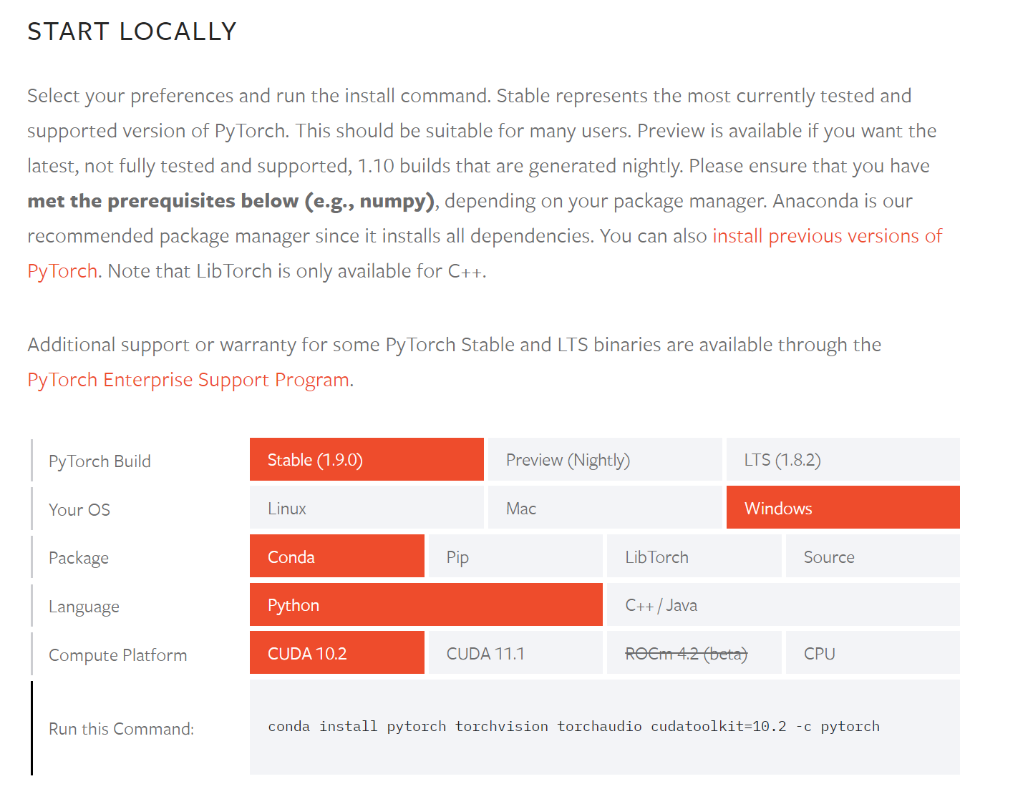
What is PyTorch
Install Pytorch and Torchvision
!pip install torch torchvision
import numpy as np
# Import torch and create the alias "th"
# instead of writing torch.name_of_a_method() , we only need to write th.name_of_a_method()
# (similarly to numpy imported as np)
import torch
# Create tensor of ones (FloatTensor by default)
ones = torch.ones(3, 2)
print(ones)

Slide 11
What is PyTorch
PyTorch Tensors
A torch.Tensor is a multi-dimensional matrix containing elements of a single data type.
Tensors are similar to numpy’s ndarrays, but they have a super-power: Tensors can also be used on a GPU to accelerate computing.
Tensor shape
Reshape tensor
# Display the shape of a tensor
# it can be used as a tuple
print("Tensor Shape: {}".format(ones.size()))
# Create a 3D tensor of size 3x2x2
zeros_3d_tensor = torch.zeros(3, 2, 2)
print("Original size:", zeros_3d_tensor.size())
# Reshape it to a 1D array of size 3*2*2 = 12
zeros_1d_array = zeros_3d_tensor.view(3 * 2 * 2)
print("Reshaped tensor:", zeros_1d_array.size())
# Let's view our original tensor as a 2D matrix
# If you want PyTorch to guess one remaining dimension,
# you specify '-1' instead of the actual size
zeros_2d_matrix = zeros_3d_tensor.view(-1, 2 * 2)
print("Matrix shape:", zeros_2d_matrix.size())
Basic Operation
2 * ones + 1
print("\n Indexing Demo:")
print(ones[:, 1])

Slide 12
What is PyTorch
Numpy Bridge
PyTorch Tensors are different from numpy arrays even if they have a lot in common
Though, it is easy with PyTorch to tranform Tensors to Numpy arrays and vice versa
# np.float32 -> torch.FloatTensor
ones_matrix = np.ones((2, 2), dtype=np.float32)
# the matrix is passed by reference:
# if we modify the original numpy array, the tensor is also edited
ones_tensor = torch.from_numpy(ones_matrix)
# Convert back to a numpy matrix
numpy_matrix = ones_tensor.numpy()
print("PyTorch Tensor:")
print(ones_tensor)
print("Numpy Matrix:")
print(numpy_matrix)
.detach().cpu().numpy()

Slide 13
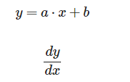
What is PyTorch
Automatic Differentiation
Pytorch tensors allow to automatically compute gradients for backpropagation.
Once you finish your computation you can call .backward() and have all the gradients computed automatically.
# We need to specify that we want to compute the gradient
# as it requires extra memory and computation
ones_tensor = torch.ones(2,2, requires_grad=True)
print(ones_tensor)
# Create a tensor and tell PyTorch
# that we want to compute the gradient
x = torch.ones(1, requires_grad=True)
# Transformation constants
a = 2
b = 5
# Define the tranformation and store the result
# in a new variable
y = a * x + b
print(y)
y.backward()
x.grad
What is a result??

Slide 14
What is PyTorch
if torch.cuda.is_available():
# Create tensors
x = torch.ones(1000, 1000)
y = 2 * x + 3
# Do the calculation on cpu (default)
start_time = time.time()
# Matrix multiplication (for benchmark purpose)
results = torch.mm(x, y)
time_cpu = time.time() - start_time
# Do the same calculation but on the gpu
# First move tensors to gpu
x = x.to("cuda")
y = y.to("cuda")
start_time = time.time()
# Matrix multiplication (for benchmark purpose)
results = torch.mm(x, y)
time_gpu = time.time() - start_time
print("Time on CPU: {:.5f}s \t Time on GPU: {:.5f}s".format(time_cpu, time_gpu))
print("Speed up: Computation was {:.0f}X faster on GPU!".format(time_cpu / time_gpu))
else:
print("You need to enable GPU accelaration in colab (runtime->change runtime type)")
PyTorch and GPU
Google colab provides a CUDA enabled GPU, so we are going to use its power.
You can move tensor to the GPU by simply using the to() method. Otherwise, PyTorch will use the CPU.
Here, we will demonstrate the usefulness of the GPU on a simple matrix multiplication
The GPUs available in Colab often include Nvidia K80s, T4s, P4s and P100s

Slide 15
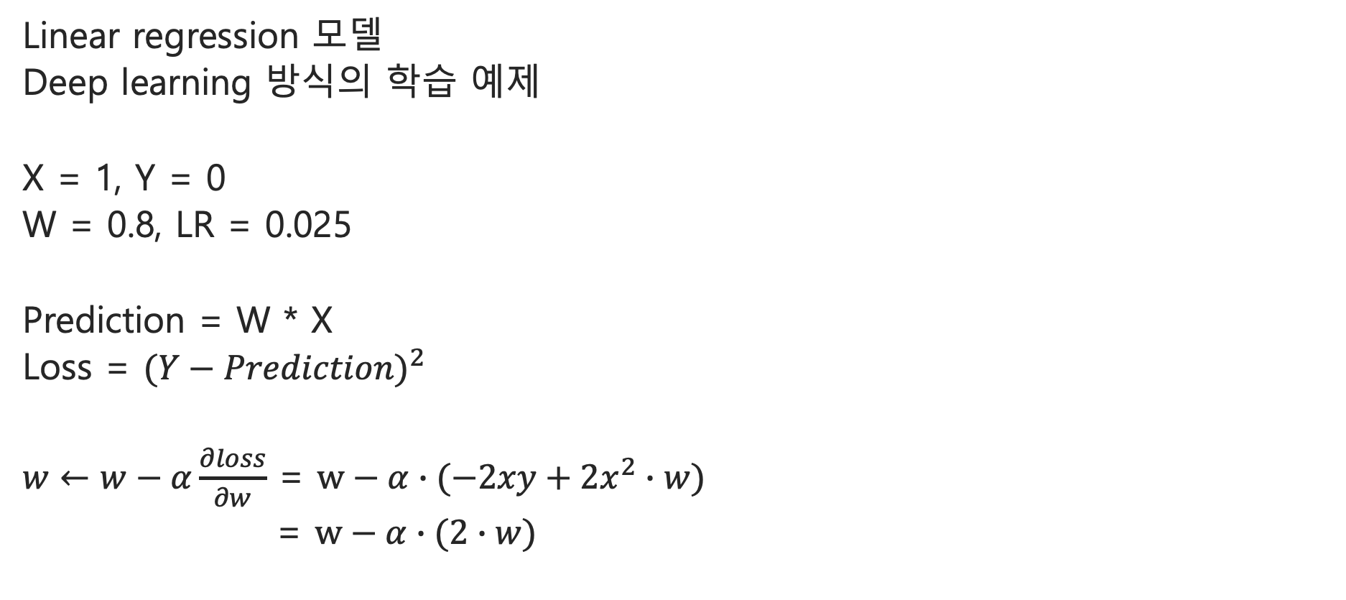
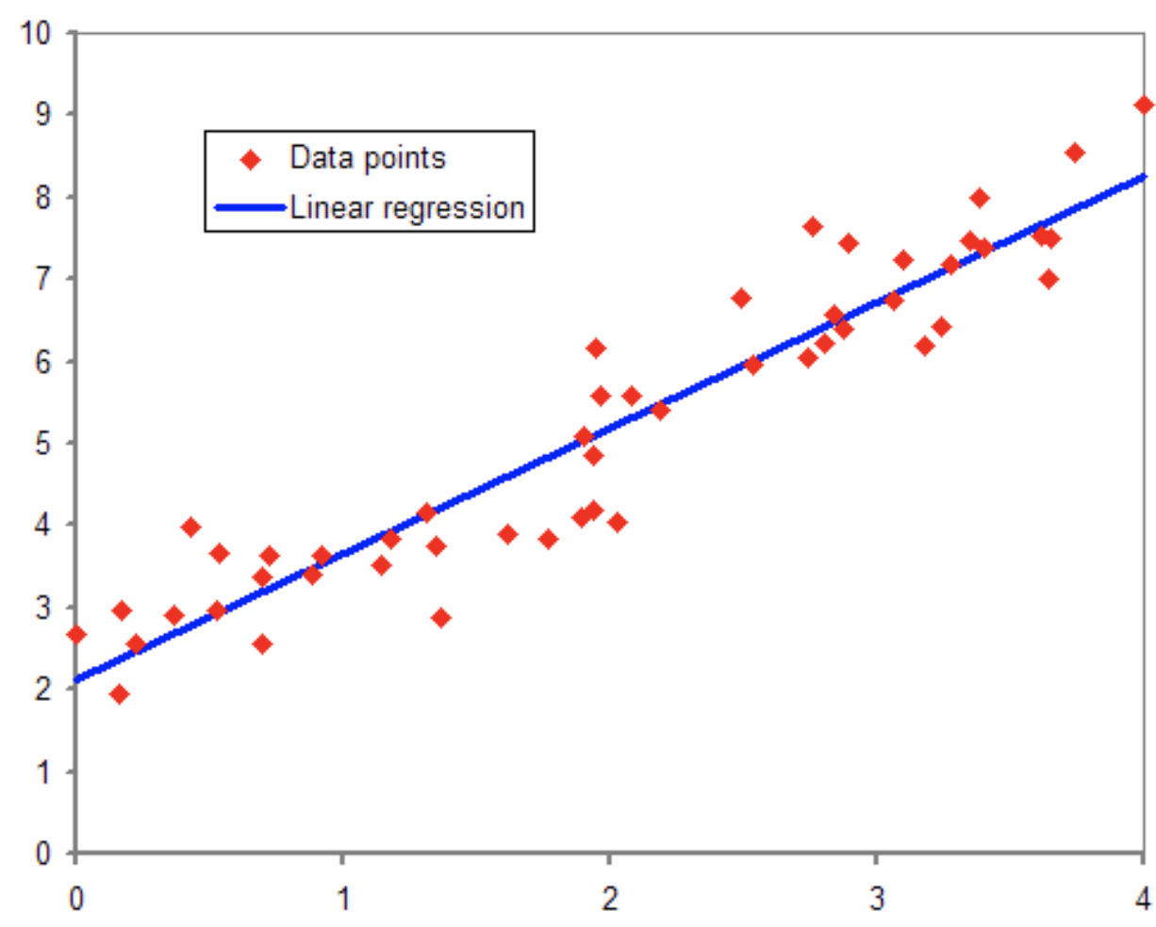
1. 기초 1 – Regression

Slide 16
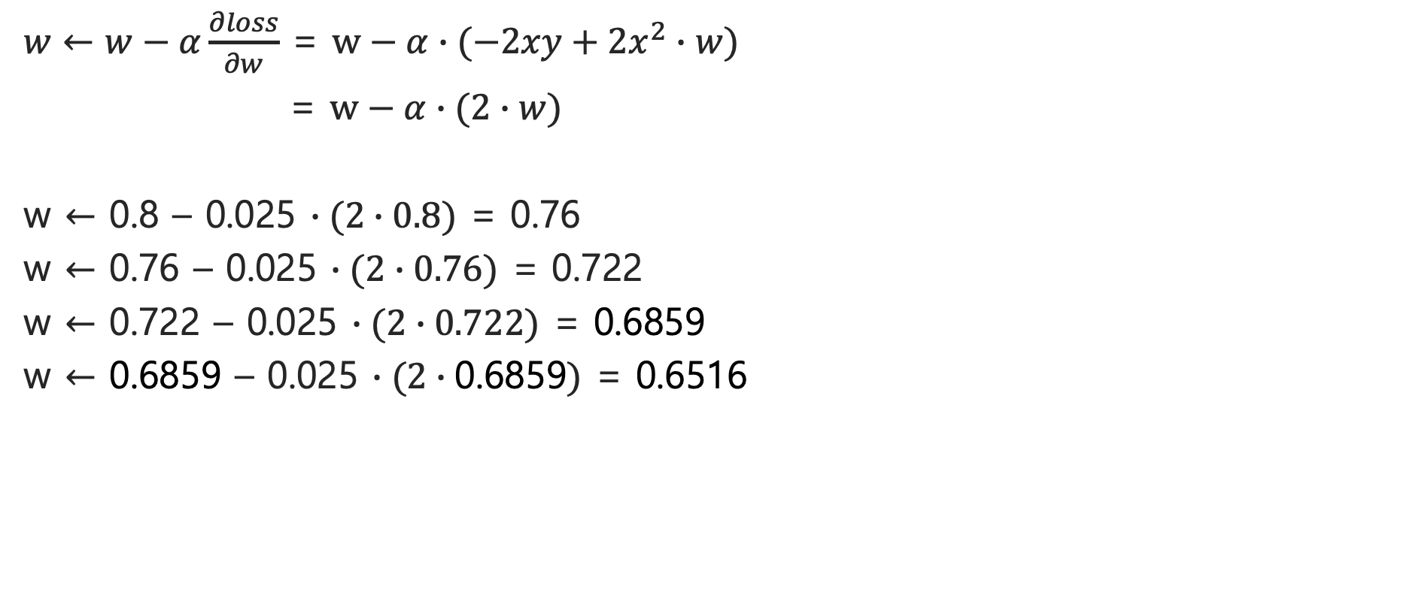
1. 기초 1 – Regression

Slide 17
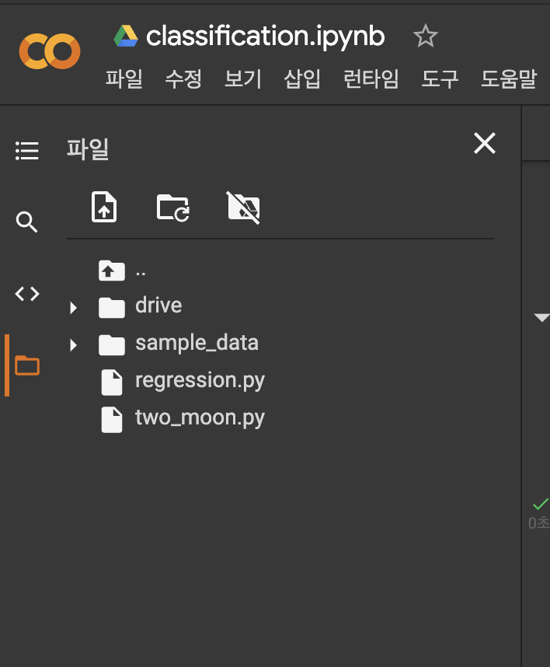
기초 1. regression 실습
좌측 파일에 regression.py 파일 생성

Slide 18
기초 1. regression 실습
!pip3 install torch==1.2.0+cu92 torchvision==0.4.0+cu92 -f https://download.pytorch.org/whl/torch_stable.html
import torch
import torch.nn as nn
x = torch.FloatTensor([1])
y = torch.FloatTensor([0])
model = nn.Linear(in_features=1, out_features=1, bias=False)
model.weight.data = torch.FloatTensor([0.8])

Slide 19
기초 1. regression 실습
optimizer = torch.optim.SGD(params=model.parameters(), lr=0.025)
for iter in range(30):
pred = model(x)
loss = torch.pow(y-pred,2)
optimizer.zero_grad()
loss.backward()
optimizer.step()
print('iter : %d, weight : %f'%(iter,model.weight.data.float()))

Slide 20
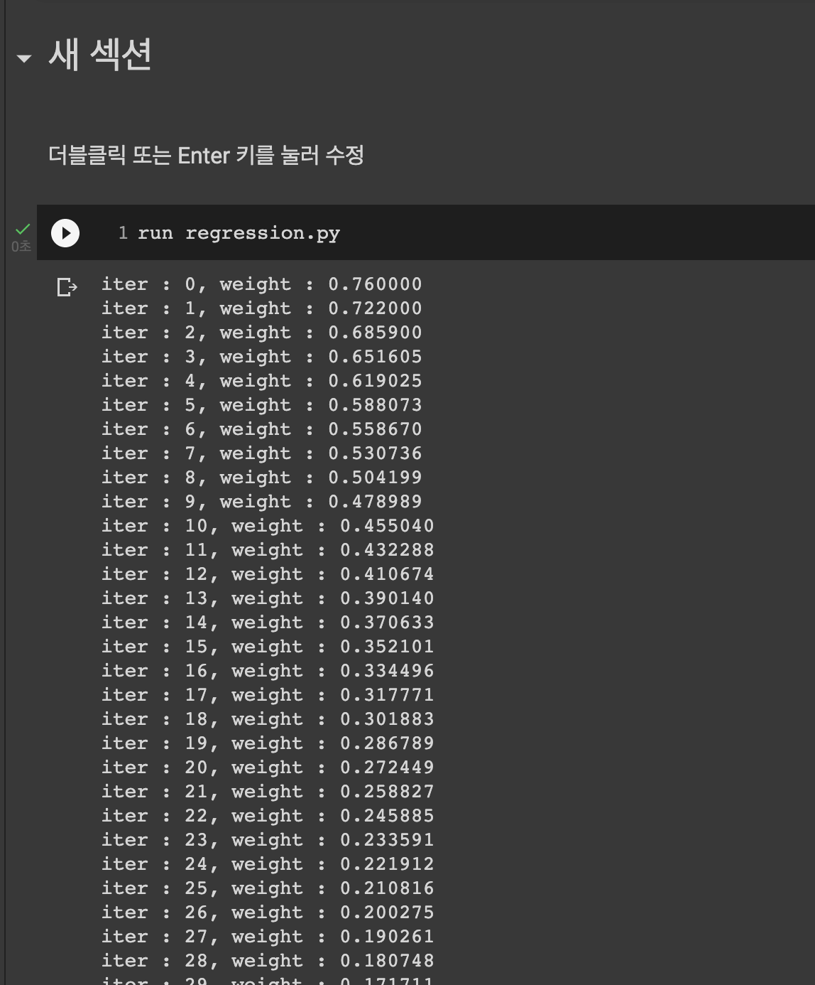
기초 1. regression 실습
새 섹션에서
Run regression.py 수행
결과 확인

Slide 21
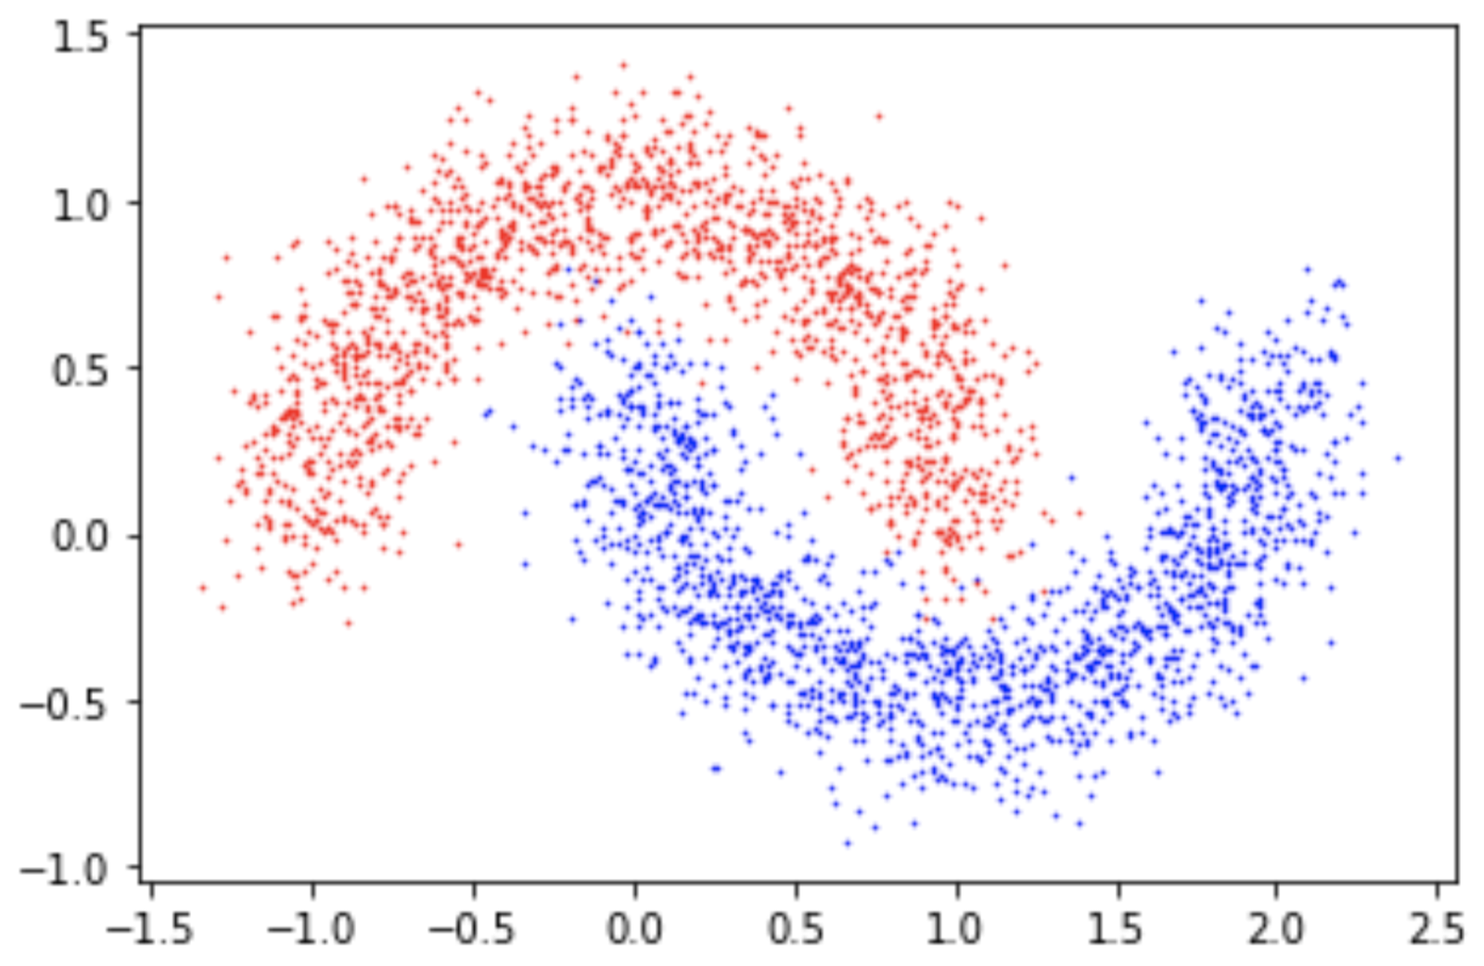
기초 2. TwoMoon 실습
Binary Classification

Slide 22
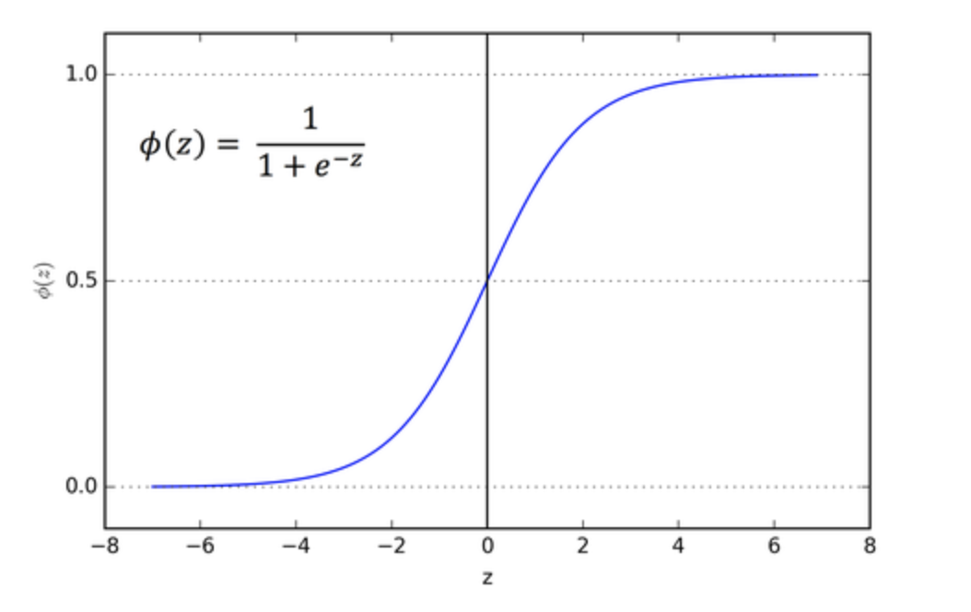
기초 2. TwoMoon 실습
Binary Classification
x1
z
x2

Slide 23
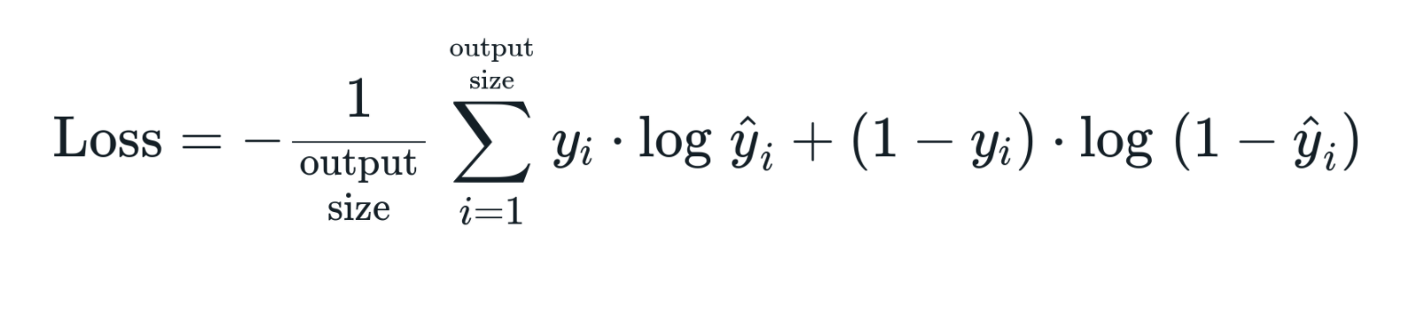
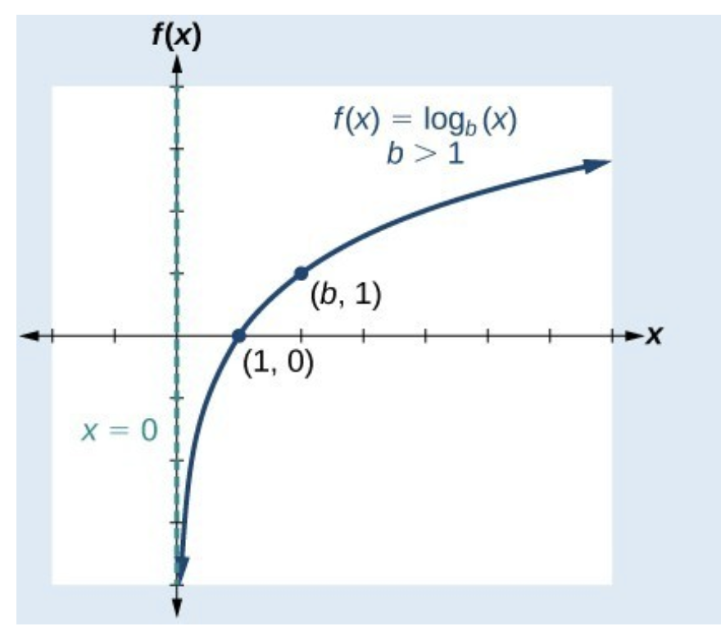
기초 2. TwoMoon 실습
Binary Classification
x1
z
x2

Slide 24
기초 2. TwoMoon 실습
import torch
import torch.nn as nn
import torch.nn.functional as F
import torchvision
import torchvision.transforms as transforms
from sklearn.datasets import make_moons
from matplotlib import pyplot
import matplotlib.pyplot as plt
import torch.utils.data as data

Slide 25
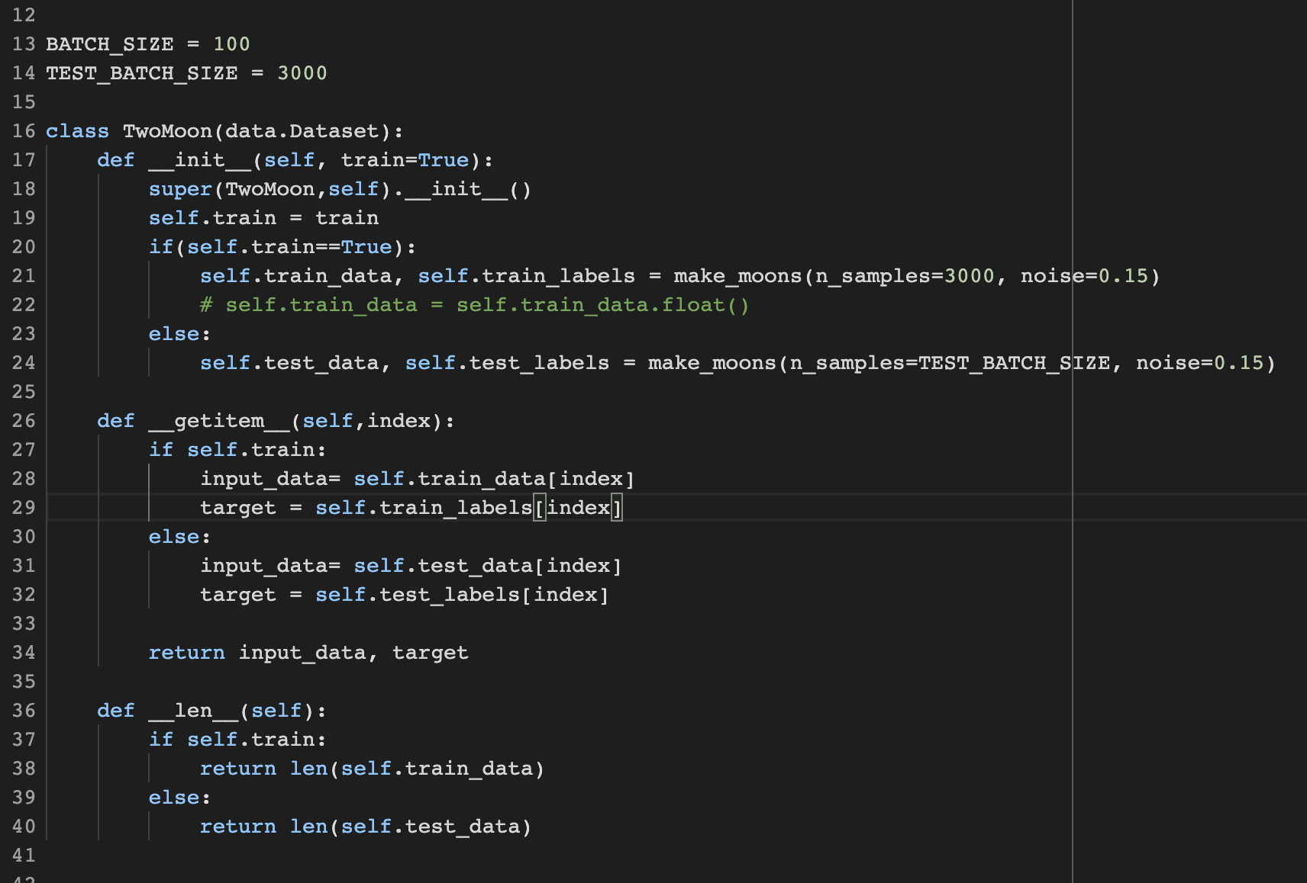
기초 2. TwoMoon 실습

Slide 26
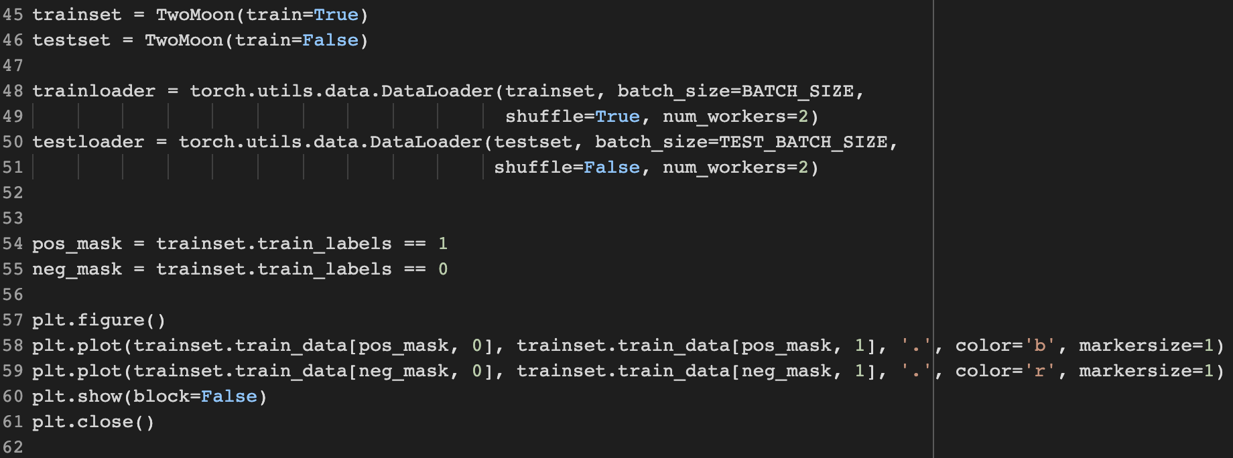
기초 2. TwoMoon 실습

Slide 27
기초 2. TwoMoon 실습
import torch
import torch.nn as nn
import torch.nn.functional as F
import torchvision
import torchvision.transforms as transforms
from sklearn.datasets import make_moons
from matplotlib import pyplot
import matplotlib.pyplot as plt
import torch.utils.data as data

Slide 28
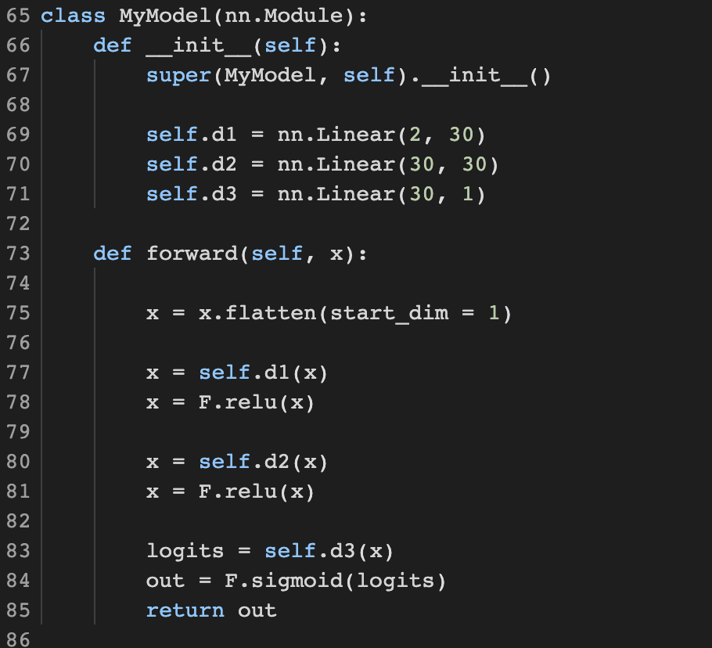
기초 2. TwoMoon 실습

Slide 29
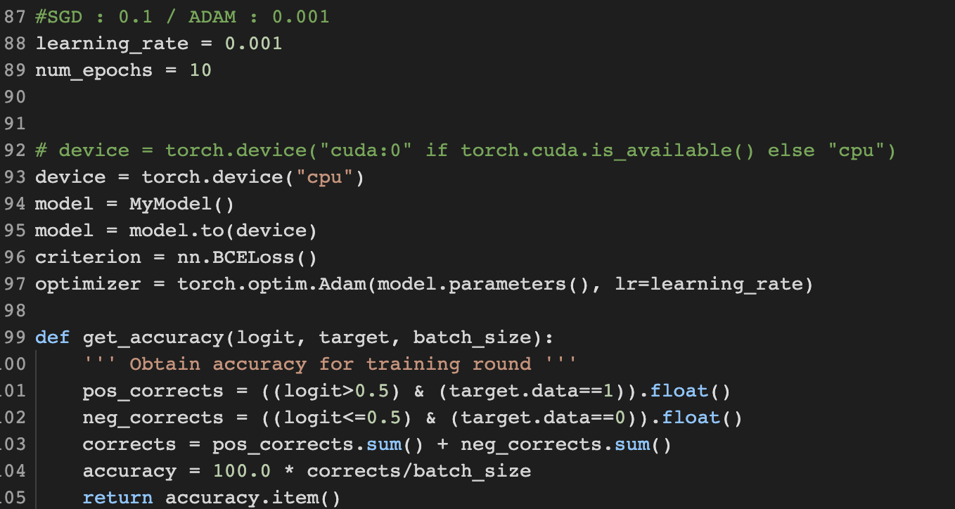
기초 2. TwoMoon 실습

Slide 30
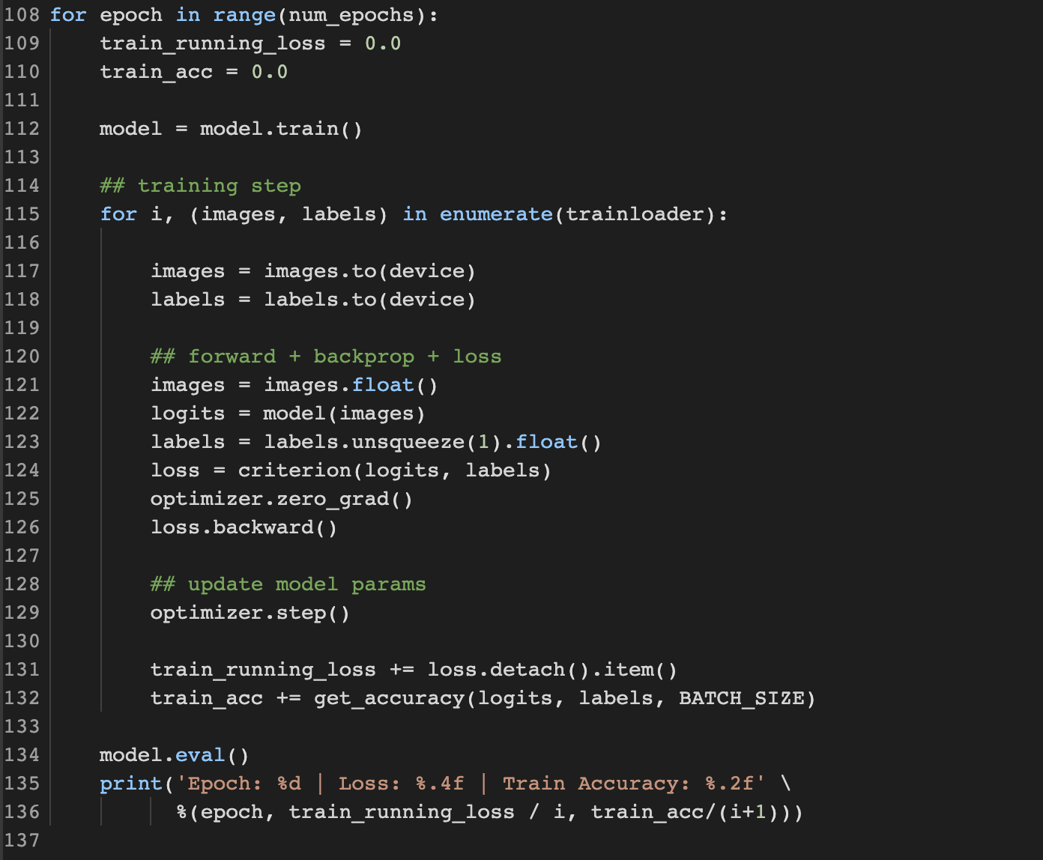
기초 2. TwoMoon 실습

Slide 31
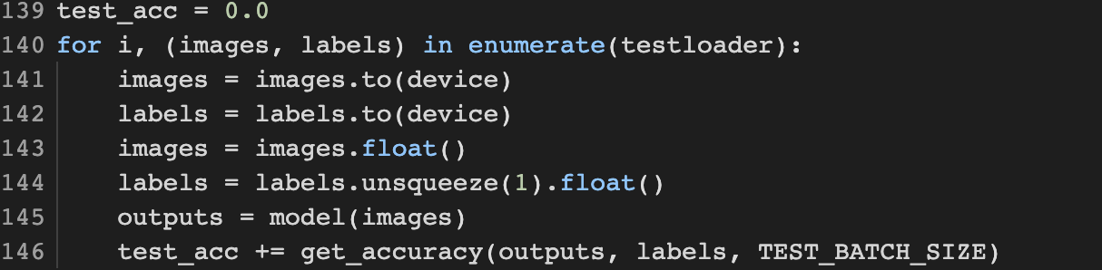
기초 2. TwoMoon 실습

Slide 32
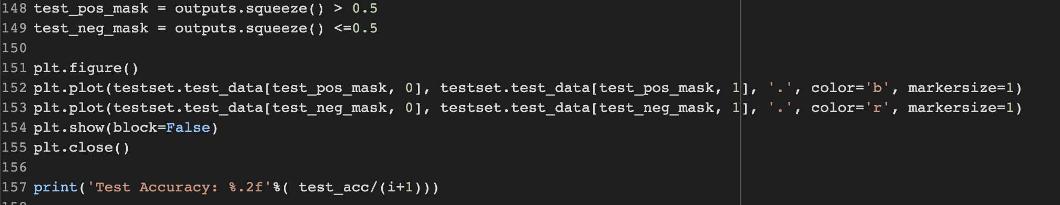
기초 2. TwoMoon 실습

Slide 33
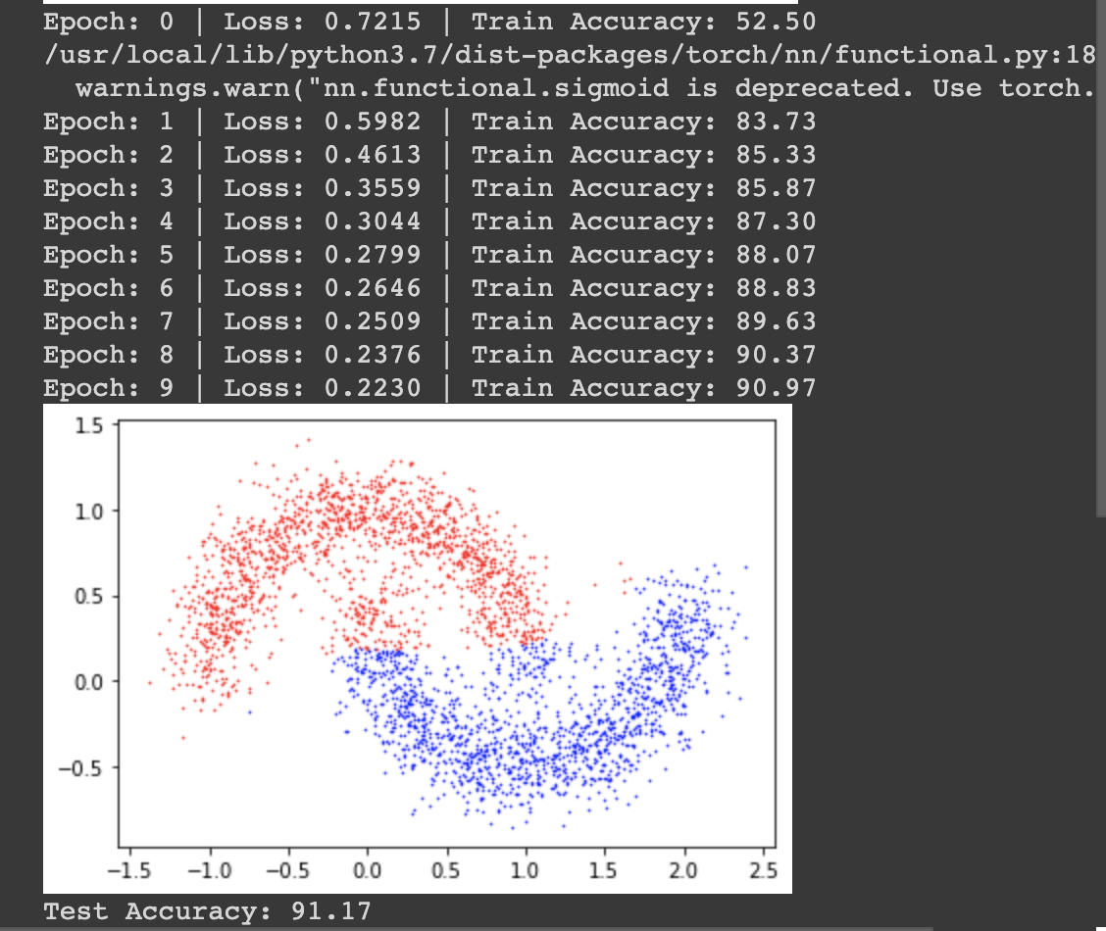
기초 2. TwoMoon 실습

Slide 34
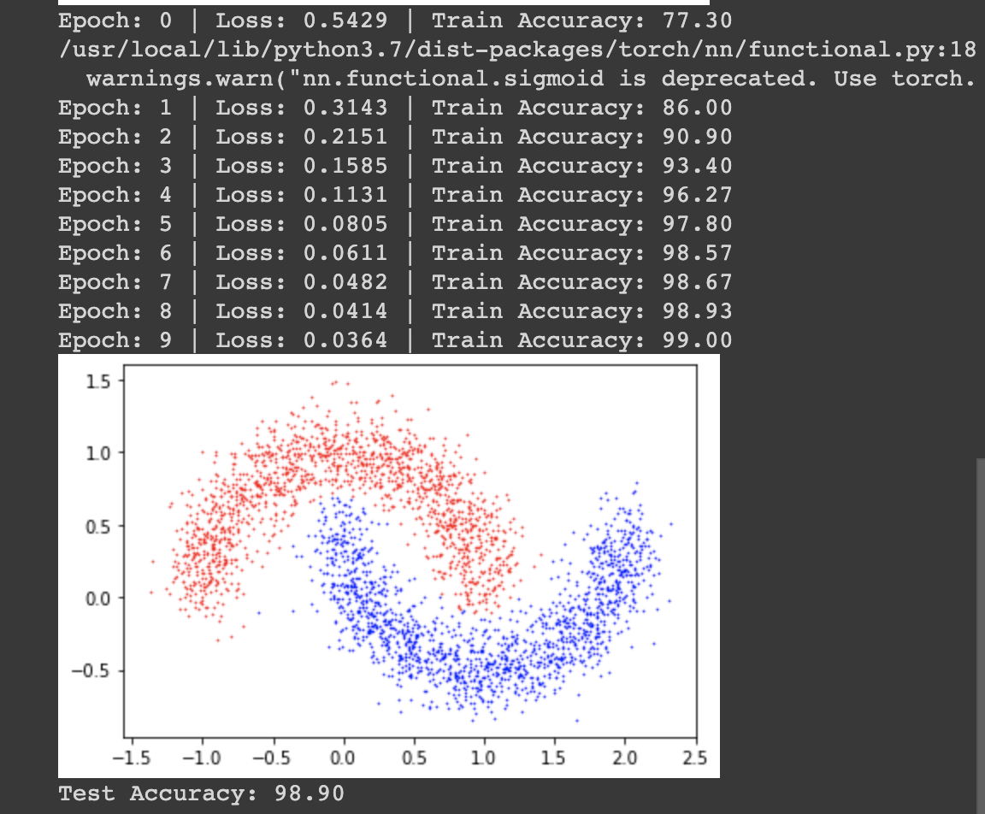
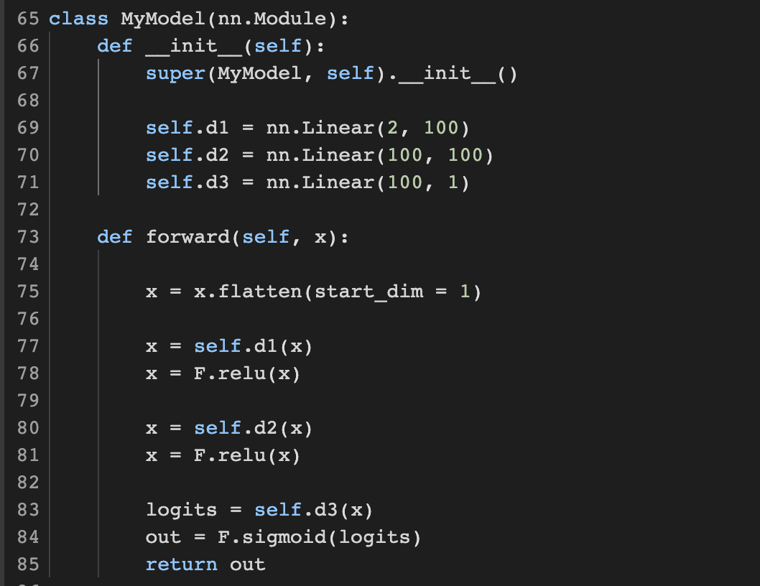
기초 2. TwoMoon2 실습
2x30 + 30x30 + 30x1 = 990
2x100 + 100x100 + 100x1.= 10,300

Slide 35
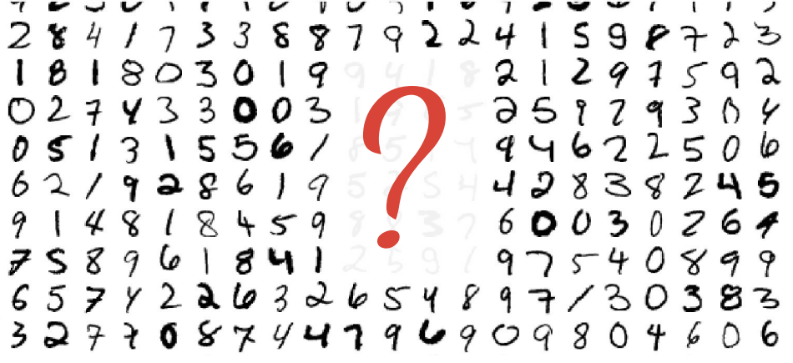
기초 3. MNIST 실습

Slide 36
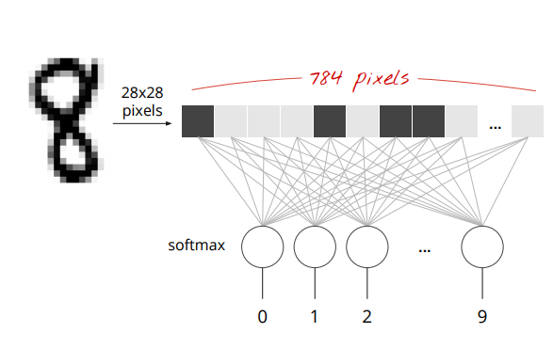
기초 3. MNIST 실습

Slide 37
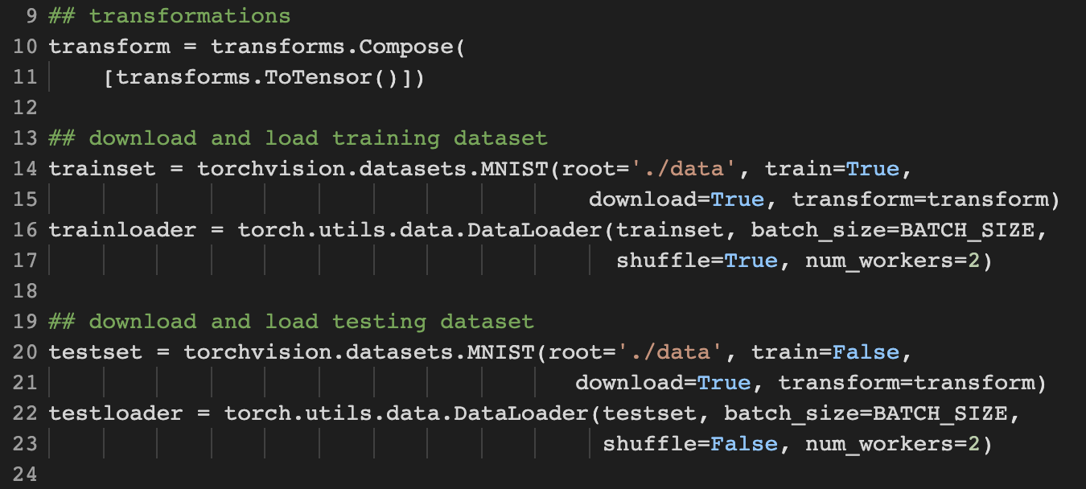
기초 3. MNIST 실습

Slide 38
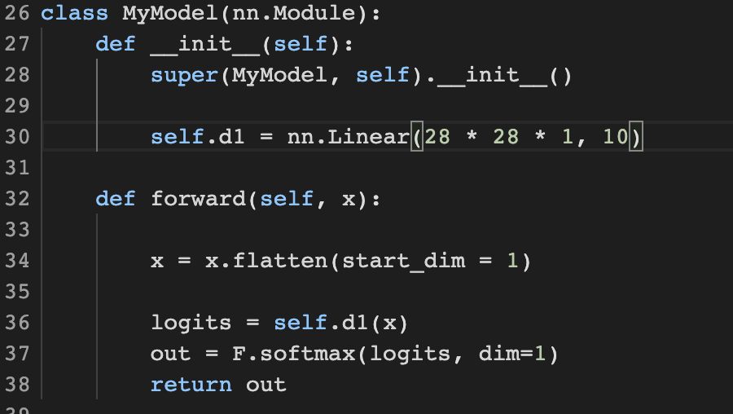
기초 3. MNIST 실습

Slide 39
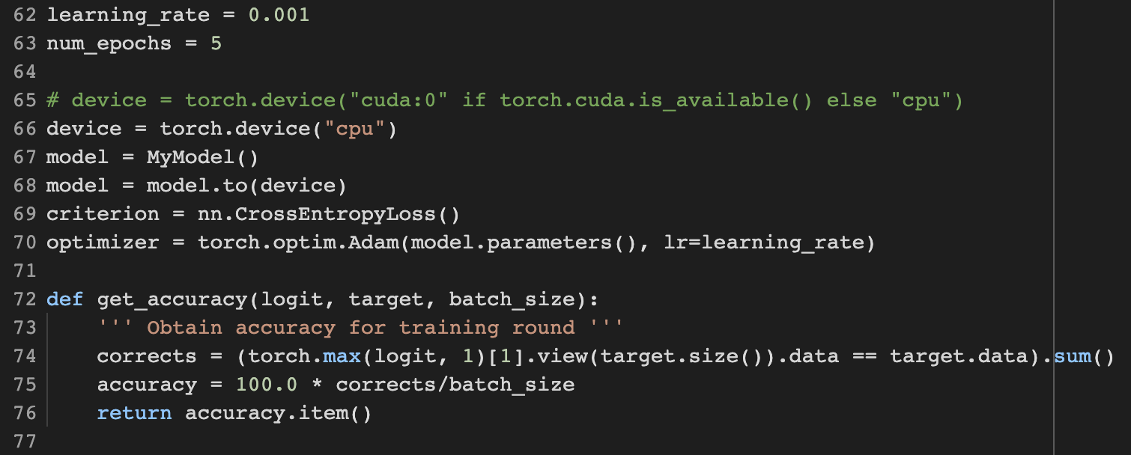
기초 3. MNIST 실습

Slide 40
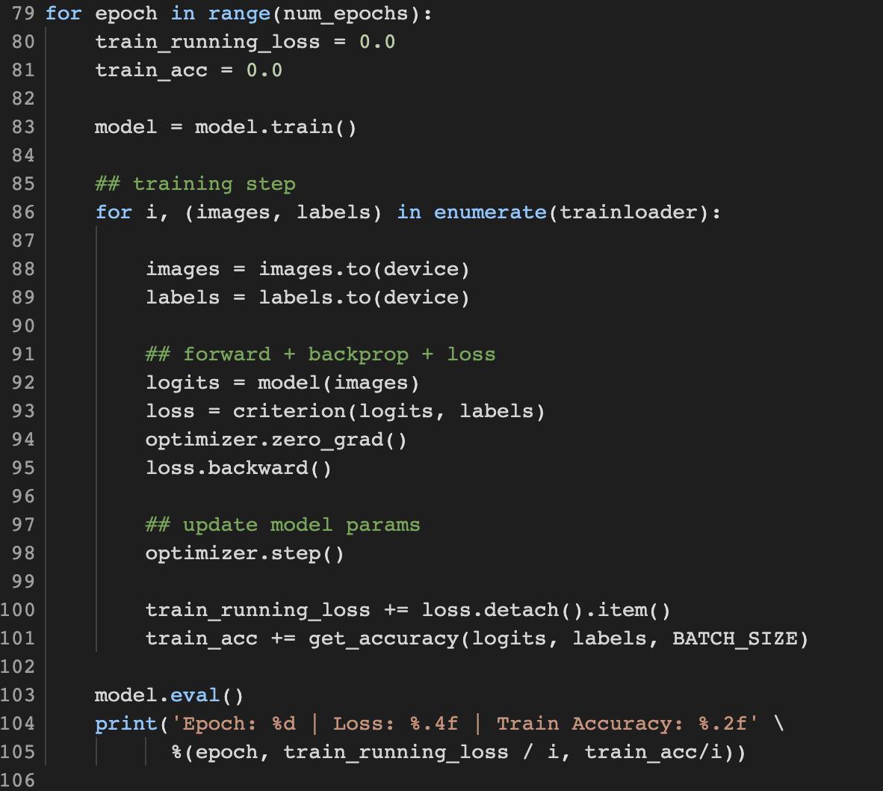
기초 3. MNIST 실습

Slide 41
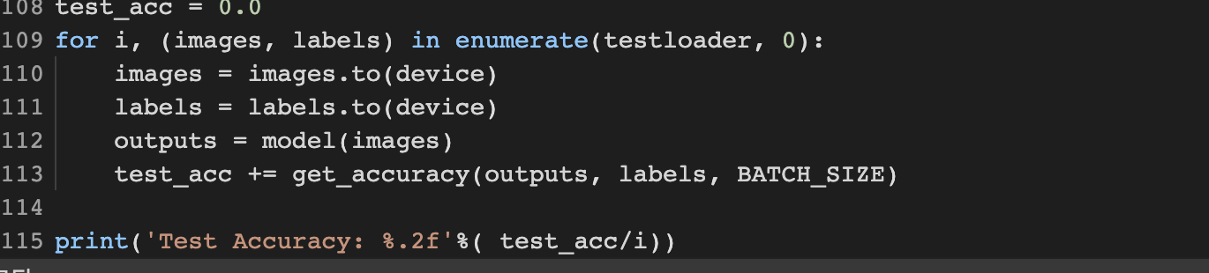
기초 3. MNIST 실습

Slide 42
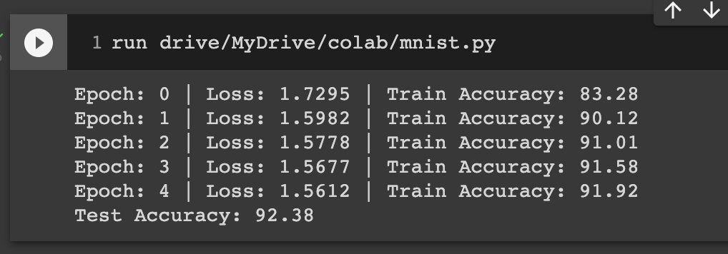
기초 3. MNIST 실습

Slide 43
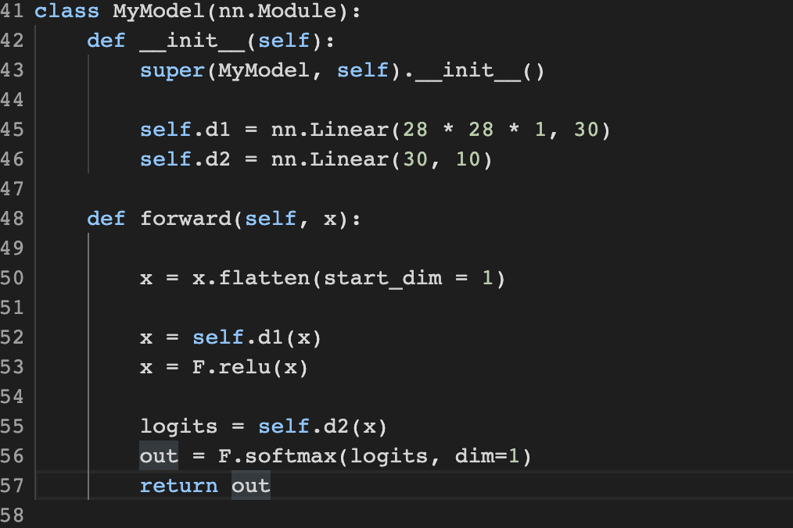
기초 3. MNIST 실습

Slide 44
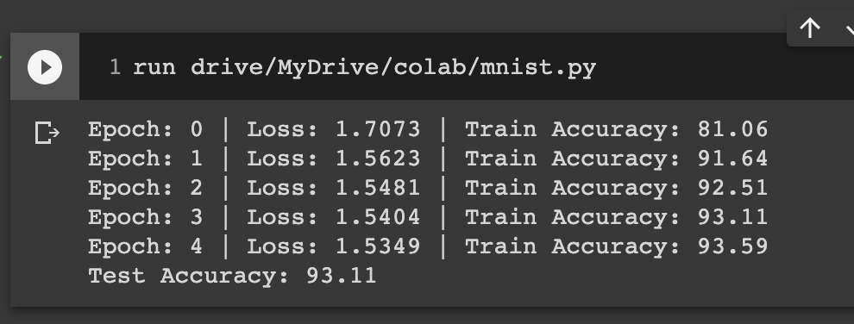
기초 3. MNIST 실습

Slide 45
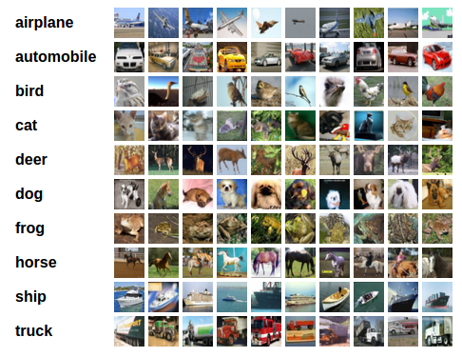
Training a classifier
Cifar10
For this tutorial, we will use the CIFAR10 dataset.
10 classes: ‘airplane’, ‘automobile’, ‘bird’, ‘cat’, ‘deer’, ‘dog’, ‘frog’, ‘horse’, ‘ship’, ‘truck’. The images in CIFAR-10 are of size 3x32x32
What we do?
Load and normalize the CIFAR10 training and test datasets using torchvision
Define a Convolution Neural Network
Define a loss function
Train the network on the training data
Test the network on the test data

Slide 46
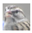

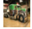
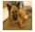
Training a classifier
4, 10 ,500, 328
Loading and normalizing CIFAR10 Dataset
from torch.utils.data.sampler import SubsetRandomSampler
n_training_samples = 20000 # Max: 50 000 - n_val_samples
n_val_samples = 5000
n_test_samples = 5000
train_sampler = SubsetRandomSampler(np.arange(n_training_samples, dtype=np.int64))
val_sampler = SubsetRandomSampler(np.arange(n_training_samples, n_training_samples + n_val_samples, dtype=np.int64))
test_sampler = SubsetRandomSampler(np.arange(n_test_samples, dtype=np.int64))
# (In the last case, indexes do not need to account for training ones because the train=False parameter in datasets.CIFAR will select from the test set)
What is SubsetRandomSampler ???
Train
Val

Slide 47
Training a classifier
Loading and normalizing CIFAR10 Dataset
The output of torchvision datasets are PILImage images of range [0, 1]. We transform them to Tensors of normalized range [-1, 1]
# get some random training images
dataiter = iter(train_loader)
images, labels = dataiter.next()
# show images
imshow(torchvision.utils.make_grid(images))
# print labels
print(' '.join('{:>10}'.format(classes[labels[j]]) for j in range(test_batch_size)))
num_workers = 2
test_batch_size = 4
transform = transforms.Compose(
[transforms.ToTensor(),
transforms.Normalize(mean=(0.5, 0.5, 0.5), std=(0.5, 0.5, 0.5))])
train_set = torchvision.datasets.CIFAR10(root='./data', train=True,
download=True, transform=transform)
train_loader = torch.utils.data.DataLoader(train_set, batch_size=test_batch_size, sampler=train_sampler,
num_workers=num_workers)
test_set = torchvision.datasets.CIFAR10(root='./data', train=False,
download=True, transform=transform)
test_loader = torch.utils.data.DataLoader(test_set, batch_size=test_batch_size, sampler=test_sampler,
num_workers=num_workers)
classes = ('plane', 'car', 'bird', 'cat',
'deer', 'dog', 'frog', 'horse', 'ship', 'truck')

Slide 48
Training a classifier
Define a Convolution Neural Network
In PyTorch, there are built-in functions that carry out the convolution steps for you.
nn.Conv2d(in_channels, out_channels, kernel_size, stride=1, padding=0): Convolution layer.
nn.MaxPool2d(kernel_size, stride=None, padding=0): Max pooling layer.
F.relu(Z1): computes the elementwise ReLU of Z1 (which can be any shape).
x.view(new_shape)
Returns a new tensor with the same data but different size. It is the equivalent of numpy function reshape (Gives a new shape to an array without changing its data).
nn.Linear(in_features, out_features)
Applies a linear transformation to the incoming data: y=Ax+b , it is also called a fully connected layer. You can read the full documentation here.
# Useful imports
import torch.nn as nn
import torch.nn.functional as F

Slide 49
Training a classifier
class SimpleConvolutionalNetwork(nn.Module):
def __init__(self):
super(SimpleConvolutionalNetwork, self).__init__()
self.conv1 = nn.Conv2d(3, 18, kernel_size=3, stride=1, padding=1)
self.pool = nn.MaxPool2d(kernel_size=2, stride=2, padding=0)
# cf comments in forward() to have step by step comments
# on the shape (how we pass from a 3x32x32 input image to a 18x16x16 volume)
self.fc1 = nn.Linear(18 * 16 * 16, 64)
self.fc2 = nn.Linear(64, 10)
def forward(self, x):
"""
Forward pass,
x shape is (batch_size, 3, 32, 32)
(color channel first)
in the comments, we omit the batch_size in the shape
"""
# shape : 3x32x32 -> 18x32x32
x = F.relu(self.conv1(x))
# 18x32x32 -> 18x16x16
x = self.pool(x)
# 18x16x16 -> 4608
x = x.view(-1, 18 * 16 * 16)
# 4608 -> 64
x = F.relu(self.fc1(x))
# 64 -> 10
# The softmax non-linearity is applied later (cf createLossAndOptimizer() fn)
x = self.fc2(x)
return x
Define a Convolution Neural Network
Simple Convolutional Neural Network
ConvNet with one convolution layer followed by a max pooling operation, one fully connected layer and an output layer

Slide 50
Training a classifier
Define a Convolution Neural Network
Linear Classifier
class LinearClassifier(nn.Module):
"""
Linear Classifier
"""
def __init__(self):
super(LinearClassifier, self).__init__()
self.linear = nn.Linear(32 * 32 * 3, 10)
def forward(self, x):
# Flatten input 3x32x32 -> 3072
x = x.view(x.size(0), -1)
return self.linear(x)

Slide 51
Training a classifier
Define a loss function
Let's use a Classification Cross-Entropy loss and ADAM optimizer (optionally, SGD with momentum).
import torch.optim as optim
def createLossAndOptimizer(net, learning_rate=0.001):
# it combines softmax with negative log likelihood loss
criterion = nn.CrossEntropyLoss()
#optimizer = optim.SGD(net.parameters(), lr=learning_rate, momentum=0.9)
optimizer = optim.Adam(net.parameters(), lr=learning_rate)
return criterion, optimizer

Slide 52
Training a classifier
Train the network on the training data
Data loader
def get_train_loader(batch_size):
return torch.utils.data.DataLoader(train_set, batch_size=batch_size, sampler=train_sampler,
num_workers=num_workers)
# Use larger batch size for validation to speed up computation
val_loader = torch.utils.data.DataLoader(train_set, batch_size=128, sampler=val_sampler,
num_workers=num_workers)

Slide 53
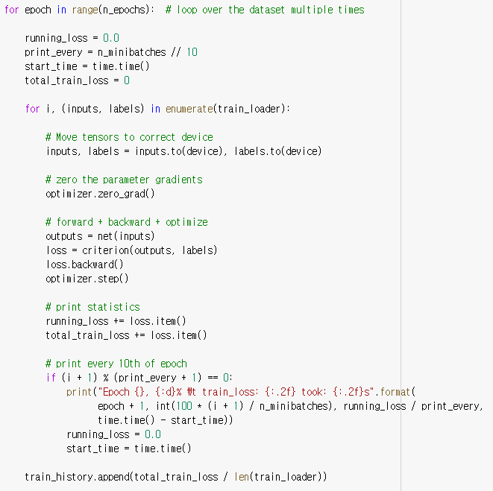
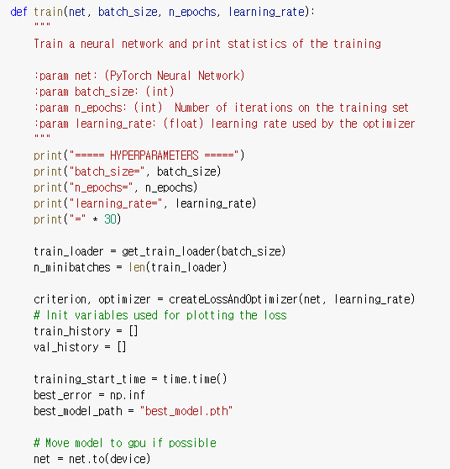
Training a classifier
Train the network

Slide 54
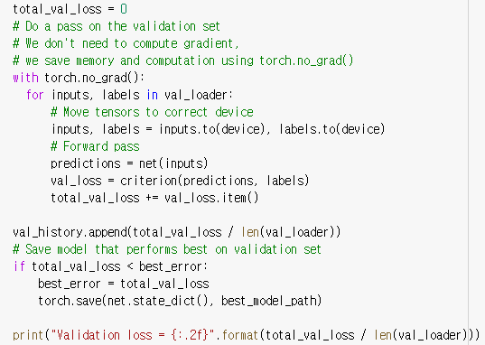
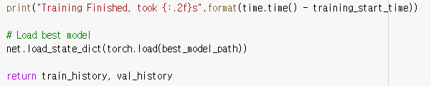
Training a classifier
Train the network on the training data

Slide 55
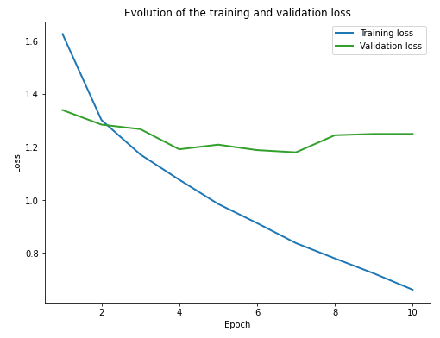
Training a classifier
Train the network on the training data
Let’s START!!!!!!
net = SimpleConvolutionalNetwork()
train_history, val_history = train(net, batch_size=32, n_epochs=10, learning_rate=0.001)
plot_losses(train_history, val_history)
Is this good plot???

Slide 56
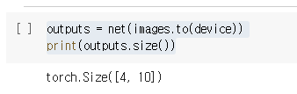
Training a classifier
Test the network on the test data
we need to check if the network has learnt anything at all.
We will check this by predicting the class label that the neural network outputs, and checking it against the ground-truth
try:
images, labels = next(iter(test_loader))
except EOFError:
pass
# print images
imshow(torchvision.utils.make_grid(images))
print("Ground truth:\n")
print(' '.join('{:>10}'.format(classes[labels[j]]) for j in range(test_batch_size)))
Let’s see what the neural network thinks these examples above are:
outputs = net(images.to(device))
print(outputs.size())
Why 4 x 10 size??

Slide 57
Training a classifier
Test the network on the test data
The outputs are probability for the 10 classes.
The higher the probability for a class, the more the network thinks that the image is from that particular class.
So, let's get the index of the highest one:
_, predicted = torch.max(outputs, 1)
print("Predicted:\n")
imshow(torchvision.utils.make_grid(images))
print(' '.join('{:>10}'.format(classes[predicted[j]]) for j in range(test_batch_size)))

Slide 58
Training a classifier
def dataset_accuracy(net, data_loader, name=""):
net = net.to(device)
correct = 0
total = 0
for images, labels in data_loader:
images, labels = images.to(device), labels.to(device)
outputs = net(images)
_, predicted = torch.max(outputs, 1)
total += labels.size(0)
correct += (predicted == labels).sum()
accuracy = 100 * float(correct) / total
print('Accuracy of the network on the {} {} images: {:.2f} %'.format(total, name, accuracy))
def train_set_accuracy(net):
dataset_accuracy(net, train_loader, "train")
def val_set_accuracy(net):
dataset_accuracy(net, val_loader, "validation")
def test_set_accuracy(net):
dataset_accuracy(net, test_loader, "test")
def compute_accuracy(net):
train_set_accuracy(net)
val_set_accuracy(net)
test_set_accuracy(net)
print("Computing accuracy...")
compute_accuracy(net)
Test the network on the test data
Calculate accuracy

Slide 59
Training a classifier
def accuracy_per_class(net):
net = net.to(device)
n_classes = 10
# (real, predicted)
confusion_matrix = np.zeros((n_classes, n_classes), dtype=np.int64)
for images, labels in test_loader:
images, labels = images, labels = images.to(device), labels.to(device)
outputs = net(images)
_, predicted = torch.max(outputs.data, 1)
for i in range(test_batch_size):
confusion_matrix[labels[i], predicted[i]] += 1
label = labels[i]
print("{:<10} {:^10}".format("Class", "Accuracy (%)"))
for i in range(n_classes):
class_total = confusion_matrix[i, :].sum()
class_correct = confusion_matrix[i, i]
percentage_correct = 100.0 * float(class_correct) / class_total
print('{:<10} {:^10.2f}'.format(classes[i], percentage_correct))
return confusion_matrix
confusion_matrix = accuracy_per_class(net)
Test the network on the test data
Calculate per class accuracy

Slide 60
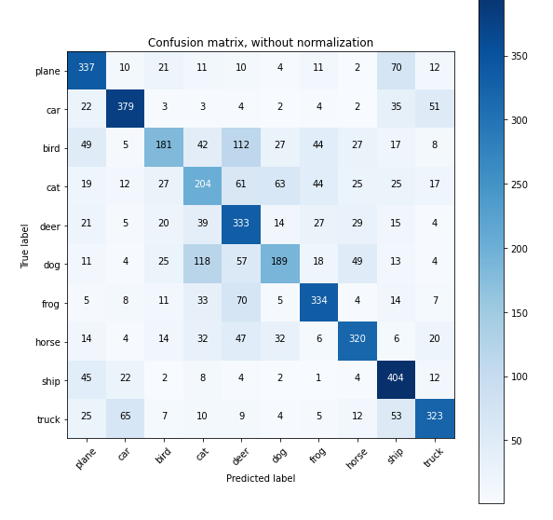
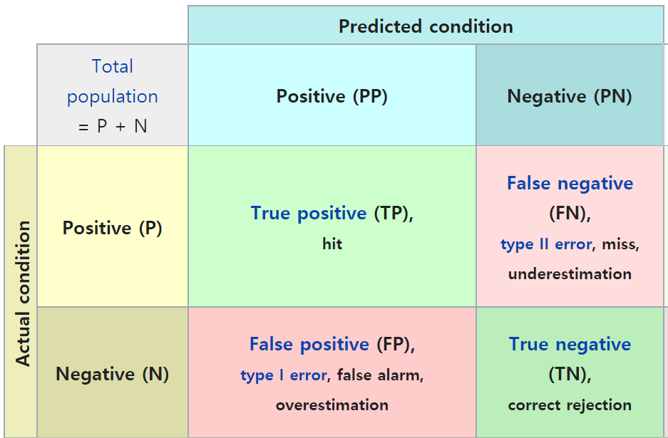
Training a classifier
Confusion Matrix
# Plot normalized confusion matrix
plot_confusion_matrix(confusion_matrix, classes, normalize=True,
title='Normalized confusion matrix')
# Plot non-normalized confusion matrix
plot_confusion_matrix(confusion_matrix, classes,
title='Confusion matrix, without normalization')

Slide 61
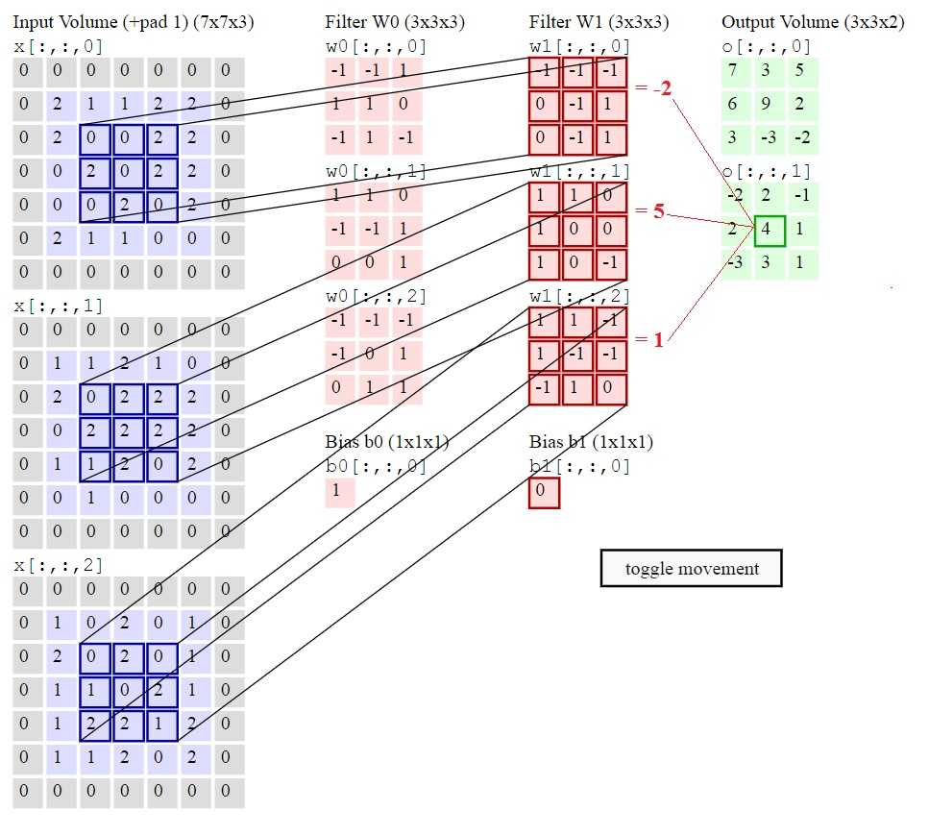
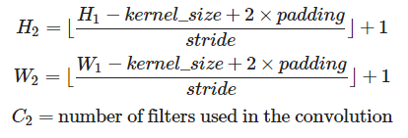
Exploring CNN Architectures
PyTorch functions to build the network
The formulas relating the output shape (C2,H2,W2) of the convolution to the input shape (C1,H1,W1) are:

Slide 62
Exploring CNN Architectures
PyTorch functions to build the network
def get_output_size(in_size, kernel_size, stride=1, padding=0):
"""
Get the output size given all the parameters of the convolution
:param in_size: (int) input size
:param kernel_size: (int)
:param stride: (int)
:param paddind: (int)
:return: (int)
"""
return int((in_size - kernel_size + 2 * padding) / stride) + 1
conv1 = nn.Conv2d(3, 18, kernel_size=7, stride=2, padding=1)
out_size = get_output_size(in_size=32, kernel_size=3, stride=1, padding=1)
print(out_size)

Slide 63
Exploring CNN Architectures
class MyConvolutionalNetwork(nn.Module):
def __init__(self):
super(MyConvolutionalNetwork, self).__init__()
self.conv1 = nn.Conv2d(3, 18, kernel_size=3, stride=1, padding=1)
self.pool = nn.MaxPool2d(kernel_size=2, stride=2, padding=0)
#### START CODE: ADD NEW LAYERS ####
# (do not forget to update `flattened_size`:
# the input size of the first fully connected layer self.fc1)
# self.conv2 = ...
# Size of the output of the last convolution:
self.flattened_size = 18 * 16 * 16
### END CODE ###
self.fc1 = nn.Linear(self.flattened_size, 64)
self.fc2 = nn.Linear(64, 10)
PyTorch functions to build the network
def forward(self, x):
"""
Forward pass,
x shape is (batch_size, 3, 32, 32)
(color channel first)
in the comments, we omit the batch_size in the shape
"""
# shape : 3x32x32 -> 18x32x32
x = F.relu(self.conv1(x))
# 18x32x32 -> 18x16x16
x = self.pool(x)
#### START CODE: USE YOUR NEW LAYERS HERE ####
# x = ...
#### END CODE ####
# Check the output size
output_size = np.prod(x.size()[1:])
assert output_size == self.flattened_size,\
"self.flattened_size is invalid {} != {}".format(output_size, self.flattened_size)
# 18x16x16 -> 4608
x = x.view(-1, self.flattened_size)
# 4608 -> 64
x = F.relu(self.fc1(x))
# 64 -> 10
x = self.fc2(x)
return x

Slide 64
Exploring CNN Architectures
PyTorch functions to build the network
net = MyConvolutionalNetwork()
train_history, val_history = train(net, batch_size=32, n_epochs=10, learning_rate=0.001)
plot_losses(train_history, val_history)
compute_accuracy(net)
confusion_matrix = accuracy_per_class(net)
plot_confusion_matrix(confusion_matrix, classes,
title='Confusion matrix, without normalization')

Slide 65
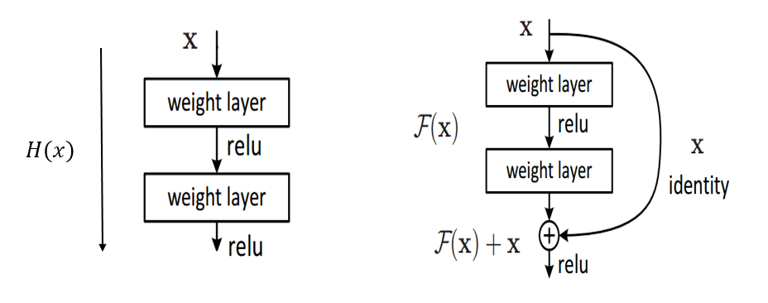
ResNet Architecture
CNN vs ResNet
Standard Block
Residual Block

Slide 66

ResNet Code explained
Basic Block vs Bottleneck Block
Basic Block
Bottleneck Block

Slide 67
ResNet Code explained
Basic Block (resnet18, resnet32)
class BasicBlock(nn.Module):
mul = 1
def __init__(self, in_planes, out_planes, stride=1):
super(BasicBlock, self).__init__()
self.conv1 = nn.Conv2d(in_planes, out_planes, kernel_size=3, stride=stride, padding=1, bias=False)
self.bn1 = nn.BatchNorm2d(out_planes)
self.conv2 = nn.Conv2d(out_planes, out_planes, kernel_size=3, stride=1, padding=1, bias=False)
self.bn2 = nn.BatchNorm2d(out_planes)
self.shortcut = nn.Sequential()
if stride != 1:
self.shortcut = nn.Sequential(
nn.Conv2d(in_planes, out_planes, kernel_size=1, stride=stride, bias=False),
nn.BatchNorm2d(out_planes)
)
def forward(self, x):
out = self.conv1(x)
out = self.bn1(out)
out = F.relu(out)
out = self.conv2(out)
out = self.bn2(out)
out += self.shortcut(x)
out = F.relu(out)
return out

Slide 68
ResNet Code explained
Bottleneck Block (resnet>=50)
class BottleNeck(nn.Module):
mul = 4
def __init__(self, in_planes, out_planes, stride=1):
super(BottleNeck, self).__init__()
self.conv1 = nn.Conv2d(in_planes, out_planes, kernel_size=1, stride=stride, bias=False)
self.bn1 = nn.BatchNorm2d(out_planes)
self.conv2 = nn.Conv2d(out_planes, out_planes, kernel_size=3, stride=1, padding=1, bias=False)
self.bn2 = nn.BatchNorm2d(out_planes)
self.conv3 = nn.Conv2d(out_planes, out_planes*self.mul, kernel_size=1, stride=1, bias=False)
self.bn3 = nn.BatchNorm2d(out_planes*self.mul)
self.shortcut = nn.Sequential()
if stride != 1 or in_planes != out_planes*self.mul:
self.shortcut = nn.Sequential(
nn.Conv2d(in_planes, out_planes*self.mul, kernel_size=1, stride=stride, bias=False),
nn.BatchNorm2d(out_planes*self.mul)
)
def forward(self, x):
out = self.conv1(x)
out = self.bn1(out)
out = F.relu(out)
out = self.conv2(out)
out = self.bn2(out)
out = F.relu(out)
out = self.conv3(out)
out = self.bn3(out)
out += self.shortcut(x)
out = F.relu(out)
return out

Slide 69
ResNet Code explained
ResNet
class ResNet(nn.Module):
def __init__(self, block, num_blocks, num_classes=10):
super(ResNet, self).__init__()
self.in_planes = 64
self.conv1 = nn.Conv2d(3, self.in_planes, kernel_size=7, stride=2, padding = 3)
self.bn1 = nn.BatchNorm2d(self.in_planes)
self.maxpool1 = nn.MaxPool2d(kernel_size=3, stride=2, padding=1)
self.layer1 = self.make_layer(block, 64, num_blocks[0], stride=1)
self.layer2 = self.make_layer(block, 128, num_blocks[1], stride=2)
self.layer3 = self.make_layer(block, 256, num_blocks[2], stride=2)
self.layer4 = self.make_layer(block, 512, num_blocks[3], stride=2)
self.avgpool = nn.AdaptiveAvgPool2d((1,1))
self.linear = nn.Linear(512 * block.mul, num_classes)
def make_layer(self, block, out_planes, num_blocks, stride):
strides = [stride] + [1] * (num_blocks-1)
layers = []
for i in range(num_blocks):
layers.append(block(self.in_planes, out_planes, strides[i]))
self.in_planes = block.mul * out_planes
return nn.Sequential(*layers)
def forward(self, x):
out = self.conv1(x)
out = self.bn1(out)
out = F.relu(out)
out = self.maxpool1(out)
out = self.layer1(out)
out = self.layer2(out)
out = self.layer3(out)
out = self.layer4(out)
out = self.avgpool(out)
out = torch.flatten(out,1)
out = self.linear(out)
return out

Slide 70
ResNet Code explained
Building Various ResNet architecture
def ResNet18():
return ResNet(BasicBlock, [2, 2, 2, 2])
def ResNet34():
return ResNet(BasicBlock, [3, 4, 6, 3])
def ResNet50():
return ResNet(BottleNeck, [3, 4, 6, 3])
def ResNet101():
return ResNet(BottleNeck, [3, 4, 23, 3])
def ResNet152():
return ResNet(BottleNeck, [3, 8, 36, 3])
ResNet 18, 34: BasicBlock,
ResNet 50>= : BottleNeck

Slide 71

Using torchvision.models
Torchvision
The models subpackage contains definitions of models for addressing different tasks
image classification, pixelwise semantic segmentation, object detection, instance segmentation, person keypoint detection and video classification.
AlexNet, VGG, ResNet, SqueezeNet, DenseNet, Inception v3, GoogLeNet, ShuffleNet v2, MobileNetV2, MobileNetV3, ResNeXt, Wide ResNet, MNASNet
https://pytorch.org/vision/stable/models.html#id10
net = torchvision.models.resnet18(pretrained = False,progress=True, num_classes=10)
train_history, val_history = train(net, batch_size=128, n_epochs=10, learning_rate=0.001)
plot_losses(train_history, val_history)

Slide 72


Using torchvision.models
Is this good results??????

Slide 73
Using torchvision.models
Using pretrained model
We need to
torchvision.models.resnet18
def resnet18(pretrained: bool = False, progress: bool = True, **kwargs: Any) -> ResNet:
r"""ResNet-18 model from
`"Deep Residual Learning for Image Recognition" <https://arxiv.org/pdf/1512.03385.pdf>`_.
Args:
pretrained (bool): If True, returns a model pre-trained on ImageNet
progress (bool): If True, displays a progress bar of the download to stderr
"""
return _resnet('resnet18', BasicBlock, [2, 2, 2, 2], pretrained, progress,
**kwargs)
model = ResNet(block, layers, **kwargs)
if pretrained:
state_dict = load_state_dict_from_url(model_urls[arch],
progress=progress)
model.load_state_dict(state_dict)
return model

Slide 74
Using torchvision.models
Using pretrained model
We need to take partial of networks due to different channel size
net = torchvision.models.vgg19(pretrained = True,progress=True)
net.fc = nn.Linear(512, 10)
train_history, val_history = train(net, batch_size=128, n_epochs=5, learning_rate=0.0001)

Slide 75




Using torchvision.models
Avoiding overfitting
Low train loss but high val loss => overfitting
Using various dataset
Regularization
optimizer = optim.Adam(net.parameters(), lr=learning_rate, weight_decay=1e-3)
transform = transforms.Compose(
[transforms.RandomCrop(32, padding=4),
transforms.RandomHorizontalFlip(),
transforms.ToTensor(),
transforms.Normalize(mean=(0.4914, 0.4822, 0.4465), std=(0.2471, 0.2435, 0.2616))])

Slide 76
Thanks
Q n A

